Slide 1
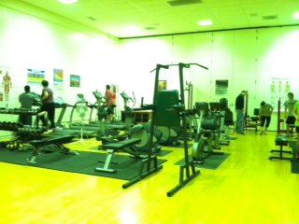

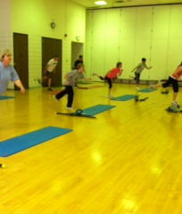

The active workday and wellness options on the campus of smsu
Kris Cleveland, PT, DPT, CSCS, CWC

Slide 2
Objectives of this presentation:
The active workday – how to incorporate more movement in your day!
Wellness options for faculty and staff
Fitness opportunities on campus

Slide 3


Slide 4
What is causing americans to become overweight?
Poor calorie choices
Sedentary lifestyle
Positive caloric balance
Positive caloric balance
Sedentary lifestyle
Poor calorie choices
Difficulty with weight management

Slide 5
Who is talking about this?
Surgeon General of the United States:
“The crisis is obesity. It’s the fastest-growing cause of disease and death in America. And it’s completely preventable. Nearly two out of every three Americans are overweight or obese. One out of every eight deaths in America is caused by an illness directly related to overweight and obesity. “
Steven Hawking:
For what it’s worth, how being sedentary has become a major problem,” Hawking says and then pauses, “is beyond my understanding.”
http://www.huffingtonpost.com/entry/stephen-hawking-obesity-psa_us_583f04b8e4b04fcaa4d61c29

Slide 6

How do we combat this?
With movement !

Slide 7
NEAT – NON Exercise ACTIVITY THERMOGENESIS
The energy expenditure of all physical activities other than volitional
sporting-like exercise
NEAT is all the moving around you do that’s separate from the time you spend intentionally exercising (at the gym or out running, etc.)
http://www.mayoclinic.org/documents/mc5810-0307-pdf/doc-20079082

Slide 8
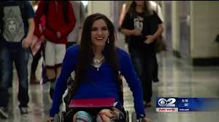
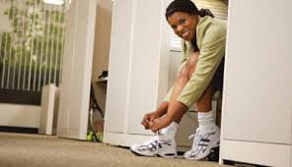
Walk or wheel – anytime, anywhere take the stairs instead of the elevator fidget more use a standing desk or ball chair walk around your office while on speaker phone garden/yardwork/housecleaning dishes by hand!
Move every 30 minutes – go talk to a co-worker, get some water stretch at your desk take an active lunch break

Slide 9
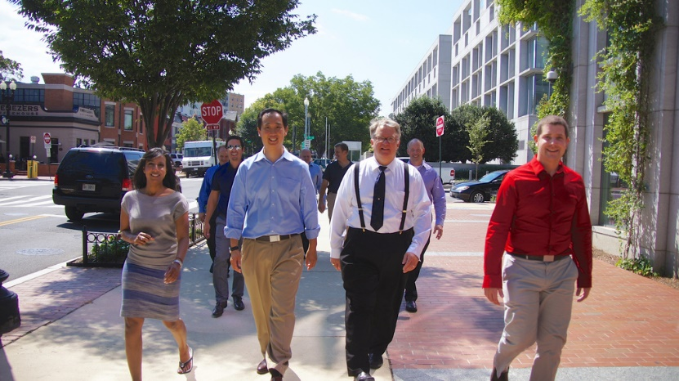
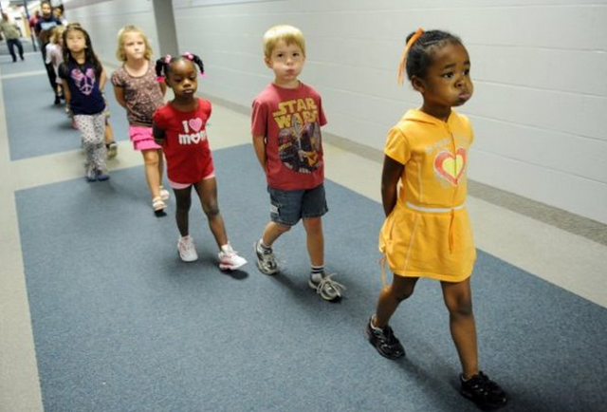

How to incorporate the active workday into your workday ……
Walking meetings/walking office hours
Walk to co-workers office …..
http://everybodywalk.org/

Slide 10
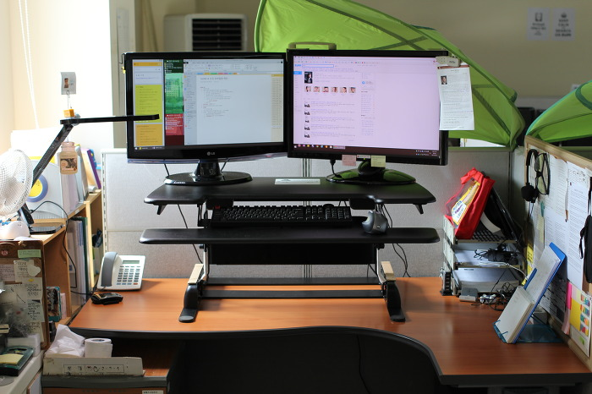
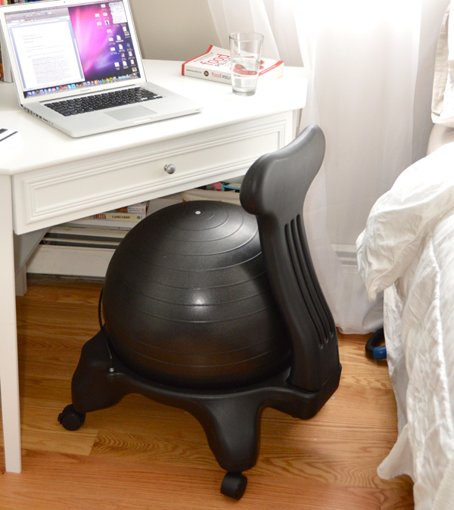
How to incorporate the active workday into your workday ……
Sit / stand desks
Ball chairs

Slide 11
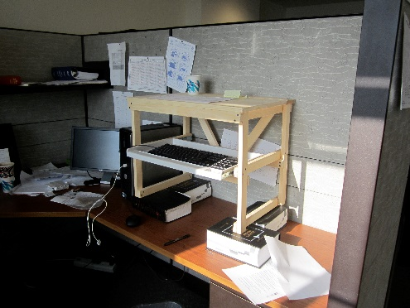
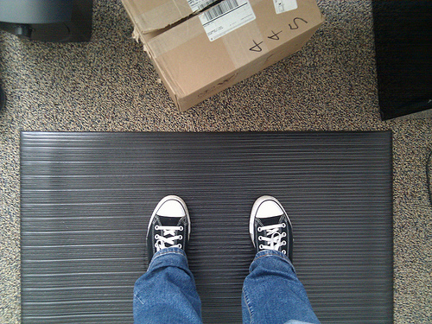
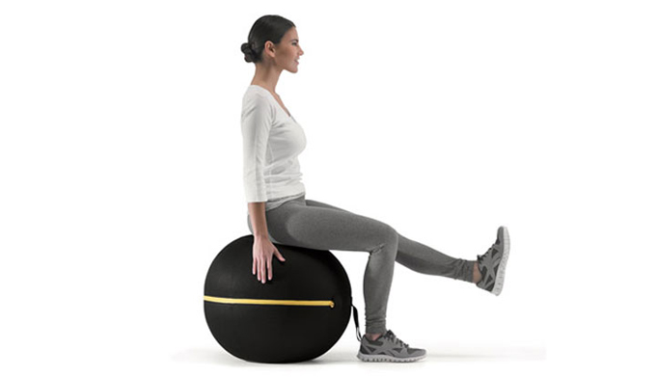
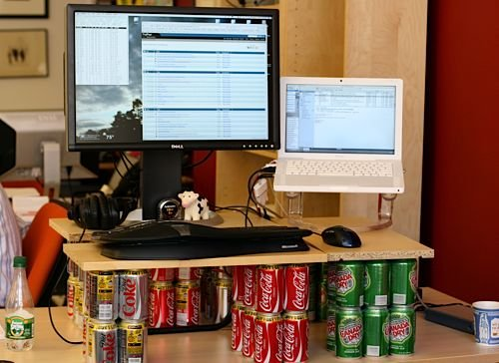
How to incorporate the active workday into your workday ……
Sit stand desks
Ball chairs

Slide 12
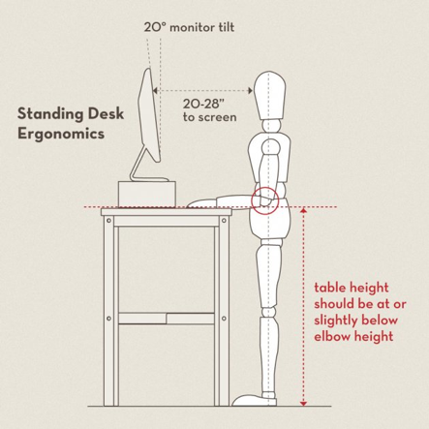
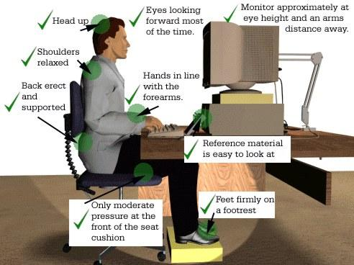
Proper postures at your work station
Standing desks
Sitting desks

Slide 13
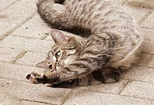
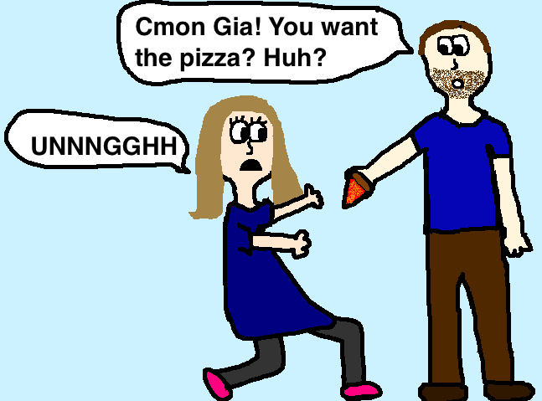
How to incorporate the active workday into your workday ……
Stretching during the day
Exercising during the day

Slide 14

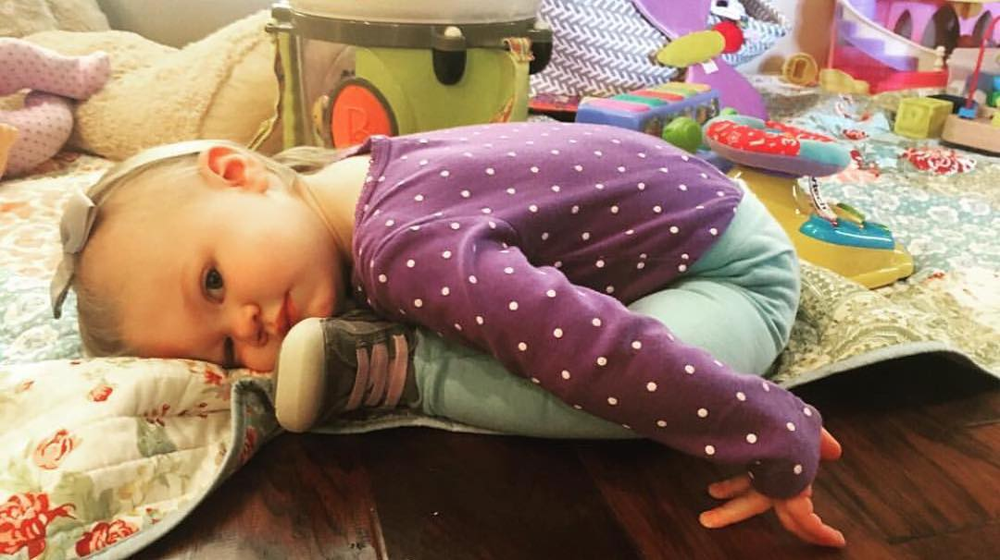
How to incorporate the active workday into your workday ……
Change positions often
Death by sitting
ROMWOD

Slide 15




Wellness options -
Insurance carrier:
Website options:
https://www.mn.gov/mmb/segip/open-enrollment/
https://mn.gov/mmb/segip/health-solutions
https://www.bluecrossmn.com/healthy/public/personal/home/livehealthy/lh-health-wellbeing
https://www.smsu.edu/campuslife/wellnessworkgroup/
http://healthy56258.org/

Slide 16
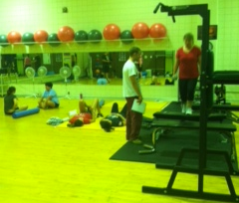
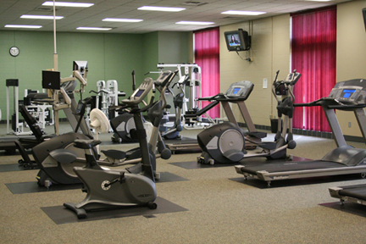
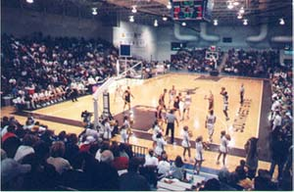
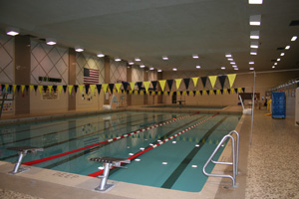
Fitness options at SMSU
SMSU Exercise Science programs
https://www.smsu.edu/academics/
programs/exercisescience/?id=9033
SMSU Fitness Facilities
Semester Membership- $35
School Year Membership - $70
Yearly Membership - $75
https://www.smsu.edu/campuslife/fitnesscenter/

Slide 17

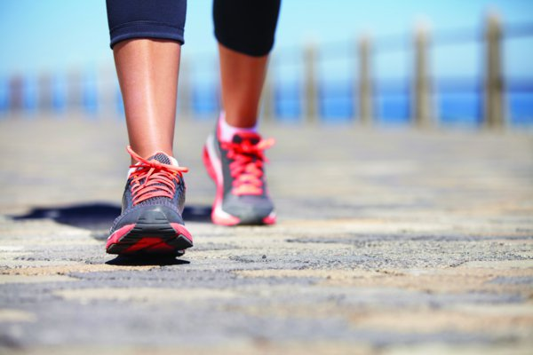

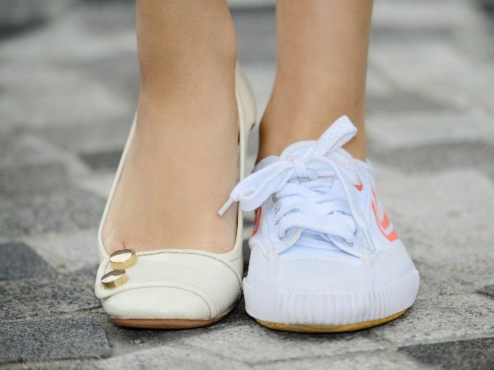
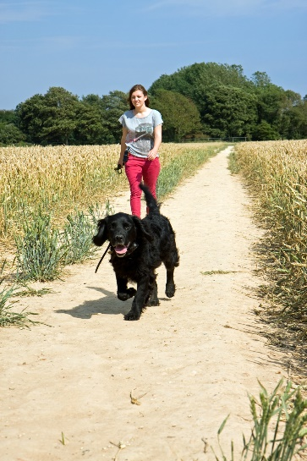
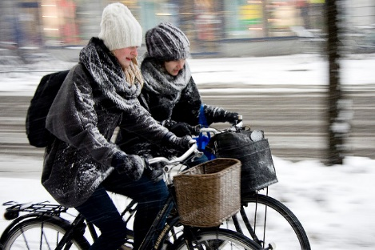
Free options – get more active!
Body weight exercises
http://greatist.com/fitness/no-gym-bodyweight-workout-infographic
Apps – there is an app for that!
http://www.myfitnesspal.com/mobile/iphone
Use your surroundings – stairs, hills, lifting everyday things
Walk walk walk

Slide 18

Livin fit swmn
January 9th join Anytime fitness, Borchs, HyVee, the Escape Spa, Health Source Chiropractic, SMSU Exercise Science Department and The Bend Studio for an 8 week Health and Wellness Challenge! Adults, kids and teams are all encouraged to sign up! Over $500 in prizes will be awarded and the grand prize winners will get the chance to donate additional funds to their favorite local charity! See the Chamber website or visit the Facebook page Livin’ Fit SWMN for more details!
Participation Information – Steps to SUCCESS!
1. Get Registered! Groups, Families and Individuals are encouraged to participate!
2. Get Social - Share Healthy Selfies and your motivation
with the group on Facebook by using #SWMNLivinFit
3. Get to the Kick off and Get your Swag- January 9th, 2017
4. Get Movin’ & Livin’ Fit – Check off your bingo card at local participating businesses!
Wellness Challenge

Slide 19

Questions?

